Slide 1
Input (C × H × W)
Global Average Pooling
(C × 1 × 1)
Squeeze-and-Excitation (SE) Module
Fully Connected Layer
(C/16 × 1 × 1)
Non-Linear (ReLU)
(C/16 × 1 × 1)
Fully Connected Layer
(C × 1 × 1)
Linear (Sigmoid)
(C × 1 × 1)
Reshape
(1 × 1 × C)
Multiply (Feature Map ⊙ Scaled Weights)
(C × H × W)
Global Average Pooling
(C × 1 × 1)
Output (C, )

Slide 2
Data
VGG16 Feature Extractor
KNN
MLP
LGBM
SVM
Logistic Regression
Accuracy
Precision
Recall/
Sensitivity
F-Score

Slide 3
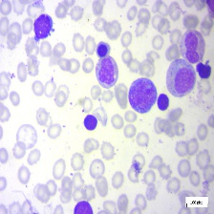
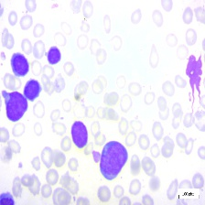
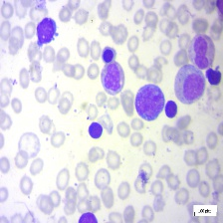
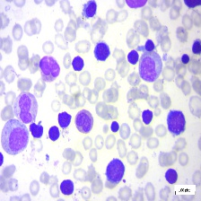

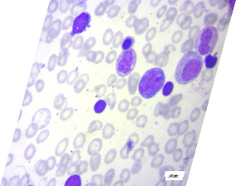

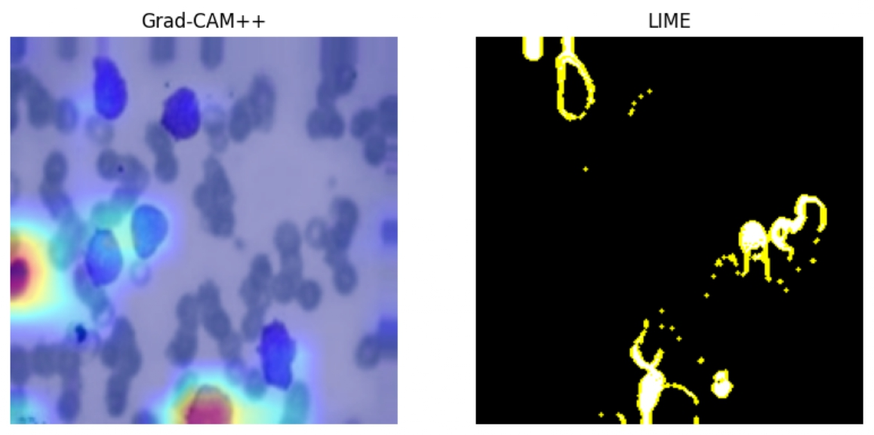
Dataset-1
Dataset-2
Merged Dataset
Augmentation
Rotate
Scale
Shear
Vahadane Normalization
Resize
Pixel Normalization
Vertical Flip
Horizontal Flip
Transfer Learning
ML- Ensemble Model
Squeeze-and-Excitation
Pretrained VGG16
Output Features
XAI
Benign
Malignant [Pro-B]
Malignant [Pre-B]
Malignant [Early Pre-B]
Classified Result
Explainable Result for
Faster Medical Attention
Heat Maps

